Slide 1
BUS SYSTEM

Slide 2
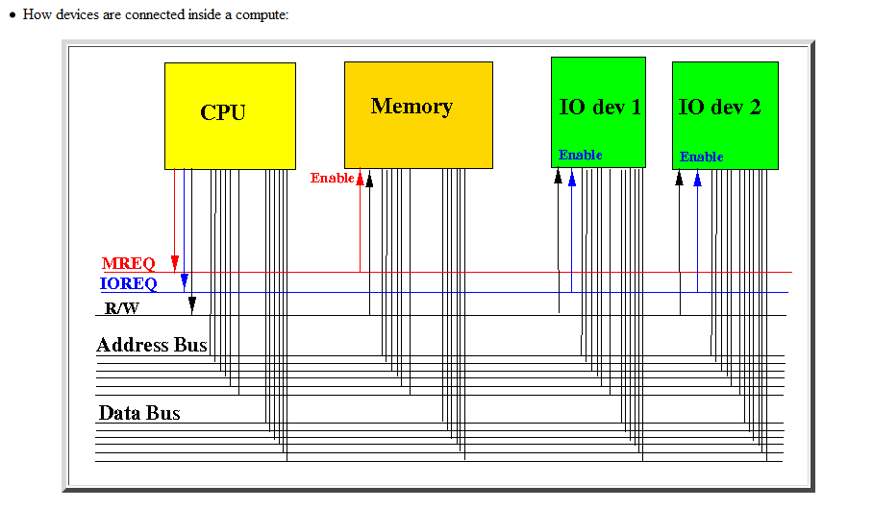
Bus System

Slide 3
Synchronous Bus
Synchronous bus (e.g., processor-memory buses)
Includes a clock in the control lines and has a fixed protocol for communication that is relative to the clock
Advantage: involves very little logic and can run very fast
Disadvantages:
Every device communicating on the bus must use same clock rate

Slide 4
Asynchronous Bus
Asynchronous bus (e.g., I/O buses)
It is not clocked, so requires a handshaking protocol and additional control lines (ReadReq, Ack, DataRdy)
Advantages:
Can accommodate a wide range of devices and device speeds
Disadvantage: slow(er)

Slide 5
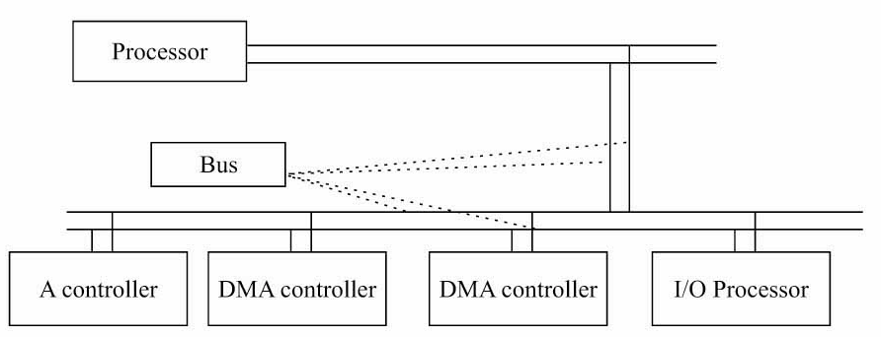
Bus Arbitration
A bus (any bus) cannot be used by more than one device at one time due to electrical properties of the devices.

Slide 6
Bus Arbitration
Before any device is allowed to perform a read/write operation using the system bus, it must first obtain permission.
A device that starts a read/write operation is called a master device
The device that it "talks" to is called the slave device

Slide 7
Bus Arbitration
Only one processor or controller can be bus master
• The bus master─ the controller that has access to a bus at an instance.
• Any one controller or processor can be the bus master at the given instance (s).

Slide 8
Bus Arbitration Methods
Centralized
Centralized bus arbitration requires hardware (arbiter)that will grant the bus to one of the requesting devices. This hardware can be part of the CPU or it can be a separate device on the motherboard.
Single hardware device controlling bus access
Bus Controller
Arbiter
Decentralized
Decentralized arbitration there isn't an arbiter, so the devices have to decide who goes next. This makes the devices more complicated, but saves the expense of having an arbiter.
Each module may claim the bus
Control logic on all modules

Slide 9
Centralized Bus Arbitration
Centralized One Level Bus Arbiter
This method of arbitration uses one centralized bus controller that all devices can query.
Centralized Two Level Bus Arbiter
Uses a Bus Request Line and Bus Grant Line for each Level

Slide 10
3 BUS ARBITRATION METHODS
1. Daisy Chain
2. Independent Bus Requests and Grant
3. Polling

Slide 11
Centralized One Level Bus Arbitration
This method of arbitration uses one centralized bus controller that all devices can query. There are 2 lines that are used:
1. Bus Request Line – A wired ‘OR’ that the controller knows a request was made, but does not know which device made the request.
2. Bus Grant Line – First a signal is propagated to all devices. The Bus Grant Line is asserted to the first device in the chain. If that device made the request it takes a hold of the bus and leaves the Bus Grant Line negated for the next device in the chain. If that device didn’t make the request then the Bus Grant Line is asserted for the next device in the chain.
If two devices make a request for the bus at the same time then the device closer to the controller gets the bus. This is called daisy chaining

Slide 12
A centralized bus arbiter using daisy chaining

Slide 13
Centralized Two Level Bus Arbitration
Centralized Two Level Bus Arbiter
Bus Request line: one for each level
Bus Grant line: one for each level
This Helps to alleviate the problem of the closest device to the
controller getting control of the bus. If more than one request
comes in at one time, control is granted based on priority. One
major advantage to this is when a lower priority device has control
of the bus, a higher priority device cannot ‘steal’ the bus from
that device.

Slide 14
Independent Requesting
U₁
U₂
…
U_{n}
The bus controller determines priority, which is programmable.
Drawback: 2n Bus request and bus grant lines to control n devices, whereas daisy chaining requires 2 such lines and polling requires log₂n lines approximately.
Bus Controller
Bus Grant1
Bus Request1
Bus Grant2
Bus Request2
Bus Grant n
Bus Request n
Bus Busy
Bus

Slide 15
polling
Unit requests the bus via BUS request line.
In response, the Bus controller proceeds to generate a sequence of numbers on the poll-count lines.
Each unit compares to the unique address assigned to it.
When requesting unit finds the match, Bus Busy signal is activated.
In response, bus controller terminates the polling process and U_{i} connects to the bus.
Advantage: failure of one unit need not affect the other units.
Disadvantage: expensive because of more control lines. Number of units are limited based on the poll-count lines capability

Slide 16
Polling
U₁
U₂
U_{n}
Bus Controller
…
Poll
Count
Bus
Bus Request
Bus Busy

Slide 17
Daisy chaining, the centralized controller always sending bus control to highest priority, which passes it to next if bus access not required.
Independent request method, the centralized controller listens to requests of each device individually and grant access to the bus on resolving its priority.
Polling method, the centralized controller does the polling of the devices and grant access to that bus which requests it on receiving the poll address.

Slide 18
References
M. M. Mano, Computer System Architecture, Prentice-Hall

